Slide 1
Anxiety Prediction Using Machine Learning
CBIO313 Final Project
Notes:
Hello! In this project, I worked on predicting anxiety using machine learning techniques. This is part of my CBIO313 course, and I’ll show you the workflow, results, and what I learned.

Slide 2
Introduction
Can ML help detect anxiety early?
Why is this important?
Notes:
Anxiety is a growing mental health concern. Our research question was: Can we predict anxiety levels based on psychological questionnaire data using machine learning? If yes, it could help with early detection and mental health awareness.

Slide 3
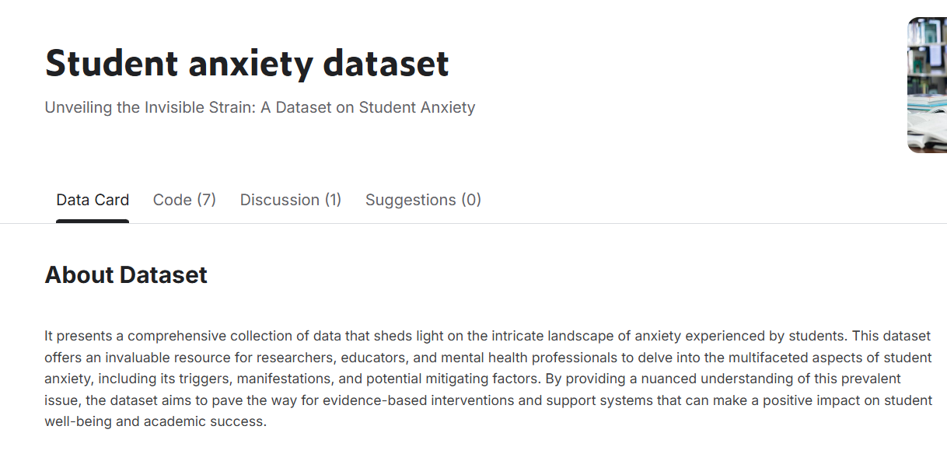
Dataset Description
10000+ Entries & 55 features
Questionnaire-based features
Target variable: GAD_T

Slide 4
Workflow
1. Data Cleaning & Scaling
2. Feature Selection
3. Model Training (5 models)
4. Evaluation & Comparison
5. Streamlit Web App Deployment

Slide 5
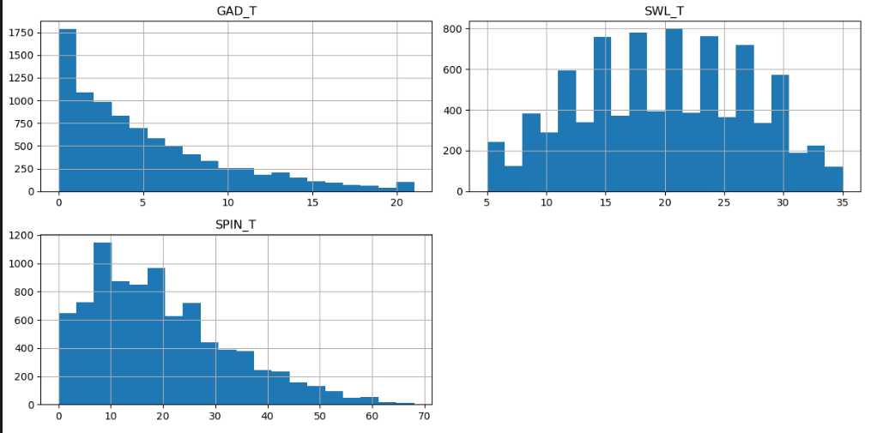
Initial Data Exploration
Distributions (GAD_T, SPIN_T, SWL_T)

Slide 6
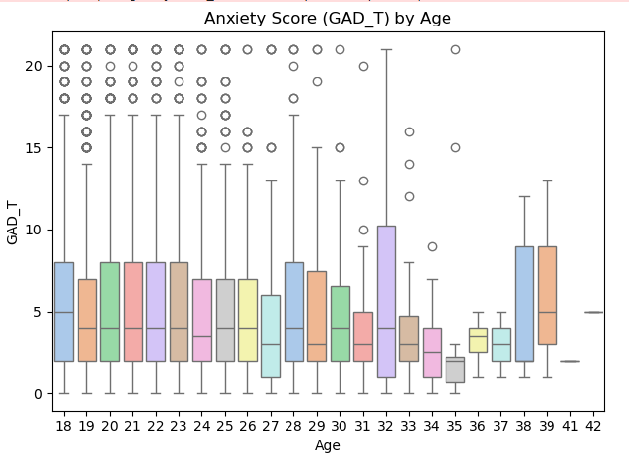
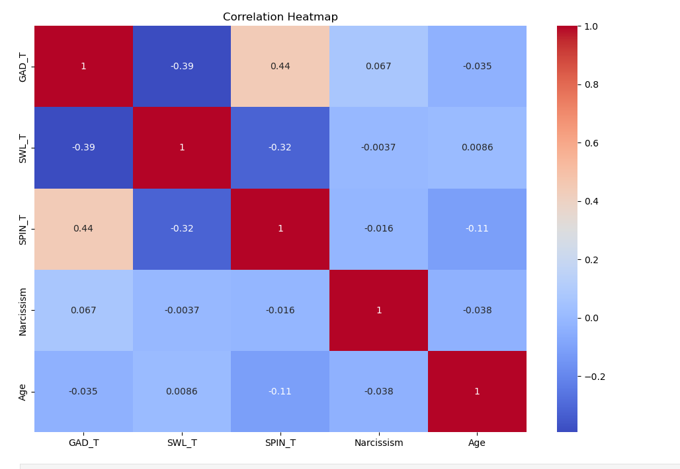
Initial Data Exploration
Age and anxiety relation
Moderate correlations

Slide 7
Modeling Approach
5 models trained :
✓ Logistic Regression
✓ Random Forest
✓ XGBoost
✓ Naive Bayes
✓ SVM
Feature selection
SMOTE used

Slide 8
Main Results
www.slidesgo.com
XGBoost & Voting: AUC = 0.96
Logistic Regression: AUC = 0.88
SMOTE improved balance

Slide 9
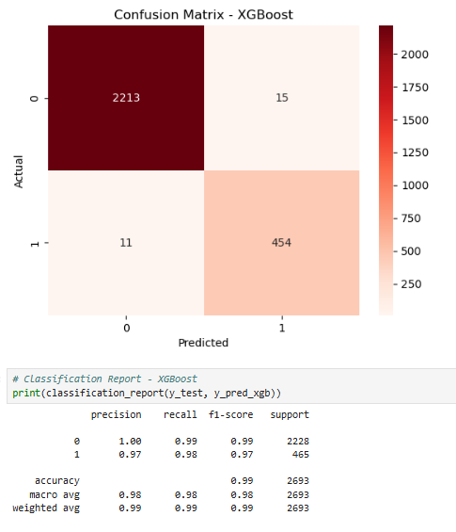
Main Results
www.slidesgo.com

Slide 10
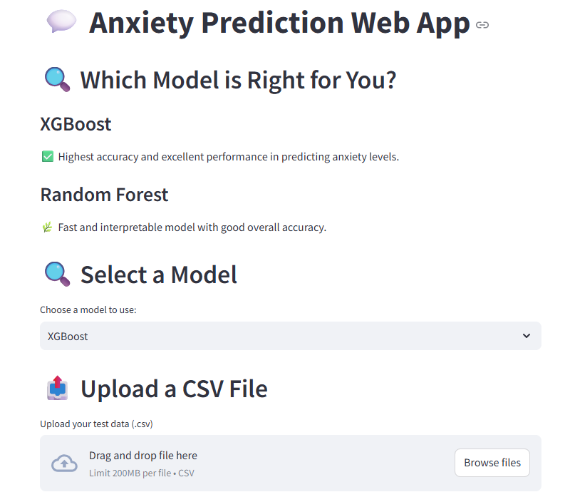
Web App Overview
www.slidesgo.com

Slide 11
Challenges Faced
• Similar/overlapping features
• File formatting in app
• Time tuning models

Slide 12
Conclusion
ML helps mental health support
Results are reliable
App ready for demo

Slide 13
Thanks !

Slide 14
App demo

